Slide 1


MALLAREDDY COLLEGE OF ENGINEERING & TECHNOLOGY
(AUTONOMUS INSTITUTION –UGC, GOVT. OF INDIA)
Affiliated to JNTUH; Approved by AICTE, NBA-Tier 1 & NAAC with A-GRADE| ISO 9001:2015
Chatnslate: The Language-Free Chat Experience
Team Members Details
1. B. Abhaya Sri - 22N31A6627
2. B. Nikhith - 22N31A6629
3. J. Sri Charan Reddy- 22N31A6666
II/III/IV Year B.Tech-I/II Semester – CSE(AIML)/AIML
Under the Guidance of
Mr. S. Venkateswara Raju
Assistant Professor
1
B.Tech III Year – II Sem | Dept of Computational Intelligence| Application Development – II | Project Review

Slide 2
MALLA REDDY COLLEGE OF ENGINEERING AND TECHNOLOGY
Agenda
Abstract
Introduction
Existing System
Proposed System
System Architecture
Requirements Specifications
System Models(UML Diagram)
Conclusion
2
B.Tech III Year – II Sem | Dept of Computational Intelligence| Application Development – II | Project Review

Slide 3
MALLA REDDY COLLEGE OF ENGINEERING AND TECHNOLOGY
Abstract
The Live Language Translator webapp is a smart and easy-to-use tool that helps people from different parts of the world chat with each other, even if they don’t speak the same language. When someone sends a message in their own language, the webapp instantly translates it into the other person’s language, so both can understand each other clearly. It feels just like a normal chat — smooth and instant. This makes it super handy for making new friends across the globe, traveling, learning new languages, or working with international teams. You don’t have to switch apps or copy-paste into a translator — everything happens right there in one place. The webapp is built using Python and uses smart NLP (Natural Language Processing) technology that helps computers understand and translate human language. It also supports real-time messaging, so your chats are instant, just like on WhatsApp or Messenger. Overall, the webapp makes it easy to connect with people from anywhere, break down language barriers, and enjoy smooth, meaningful conversations in any language.
3
B.Tech III Year – II Sem | Dept of Computational Intelligence| Application Development – II | Project Review

Slide 4
MALLA REDDY COLLEGE OF ENGINEERING AND TECHNOLOGY
Introduction
The Live Language Translator WebApp is an innovative communication tool designed to bridge language gaps and enable seamless conversations between people from different linguistic backgrounds. Built using Python and advanced Natural Language Processing (NLP) technologies, this web-based application offers real-time message translation, allowing users to chat effortlessly in their native languages. Whether for travel, international collaboration, language learning, or making new global connections, the webapp provides a smooth, chat-like experience similar to platforms like WhatsApp or Messenger. With instant translation and integrated messaging in one platform, it removes the need for switching between apps or manual translation, making cross-language communication natural, efficient, and accessible to everyone.
4
B.Tech III Year – II Sem | Dept of Computational Intelligence| Application Development – II | Project Review

Slide 5
There is a lack of real-time, built-in translation features in most messaging platforms.
MALLA REDDY COLLEGE OF ENGINEERING AND TECHNOLOGY
Existing System
People often handle language differences by copying and pasting messages into separate translation apps like Google Translate.
This manual process interrupts the flow of conversation and slows down communication.
It becomes especially frustrating in fast-moving chats, group discussions, or international work settings.
There is a lack of real-time, built-in translation features in most messaging platforms.
These language barriers can lead to misunderstandings or make people feel excluded.
A real-time translation solution is needed to make multilingual conversations smooth, natural, and inclusive.
5
B.Tech III Year – II Sem | Dept of Computational Intelligence| Application Development – II | Project Review

Slide 6
MALLA REDDY COLLEGE OF ENGINEERING AND TECHNOLOGY
Proposed System
A web-based chat platform that enables real-time messaging and automatic translation, allowing users who speak different languages to communicate effortlessly in one place.
Developed using Python and powered by Natural Language Processing (NLP) to understand and translate messages instantly during the conversation.
Feels like using popular messaging apps (e.g., WhatsApp or Messenger), with a smooth and user-friendly interface.
Removes the need to switch between apps or use external translation tools, making conversations fast and natural.
Ideal for global communication — useful in travel, international teamwork, language learning, and making new friends worldwide.
6
B.Tech III Year – II Sem | Dept of Computational Intelligence| Application Development – II | Project Review

Slide 7
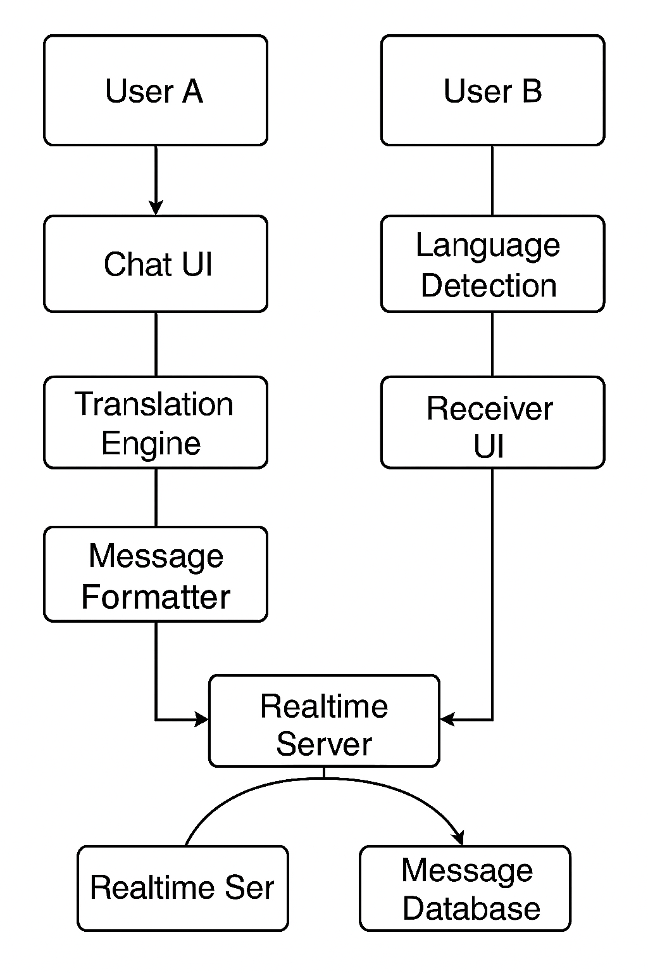
MALLA REDDY COLLEGE OF ENGINEERING AND TECHNOLOGY
System Architecture
7
B.Tech III Year – II Sem | Dept of Computational Intelligence| Application Development – II | Project Review

Slide 8
MALLA REDDY COLLEGE OF ENGINEERING AND TECHNOLOGY
Requirement
Specifications
8
B.Tech III Year – II Sem | Dept of Computational Intelligence| Application Development – II | Project Review

Slide 9
MALLA REDDY COLLEGE OF ENGINEERING AND TECHNOLOGY
Software Requirements Specifications
Google Gemini AI API for translation services
Clerk authentication service
Next.js framework for web application
WebSocket protocol for real-time messaging
RESTful API endpoints for data operations
9
B.Tech III Year – II Sem | Dept of Computational Intelligence| Application Development – II | Project Review

Slide 10
MALLA REDDY COLLEGE OF ENGINEERING AND TECHNOLOGY
Hardware Requirements Specifications
Processor: Intel i5 or above
Memory: 4GB RAM minimum
Storage: 128GB HDD/SSD
Network: Stable internet connection
10
B.Tech III Year – II Sem | Dept of Computational Intelligence| Application Development – II | Project Review

Slide 11
MALLA REDDY COLLEGE OF ENGINEERING AND TECHNOLOGY
System Models
(UML Diagrams)
11
B.Tech III Year – II Sem | Dept of Computational Intelligence| Application Development – II | Project Review

Slide 12
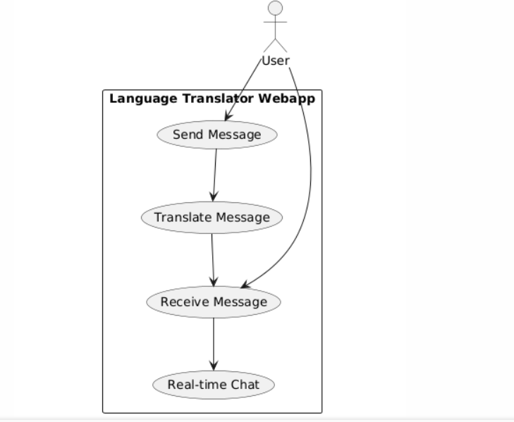
MALLA REDDY COLLEGE OF ENGINEERING AND TECHNOLOGY
Use Case Diagram
12
B.Tech III Year – II Sem | Dept of Computational Intelligence| Application Development – II | Project Review

Slide 13
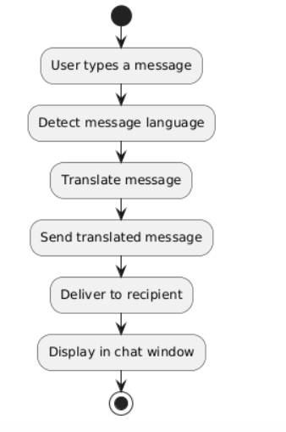
MALLA REDDY COLLEGE OF ENGINEERING AND TECHNOLOGY
Activity Diagram
13
B.Tech III Year – II Sem | Dept of Computational Intelligence| Application Development – II | Project Review

Slide 14
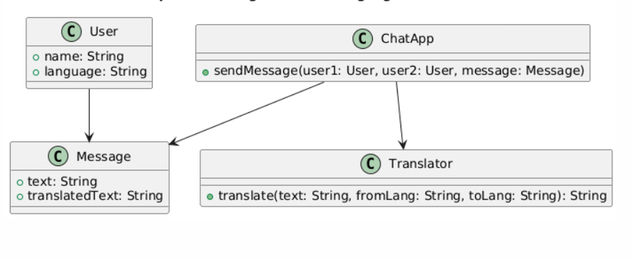
MALLA REDDY COLLEGE OF ENGINEERING AND TECHNOLOGY
Class Diagram
14
B.Tech III Year – II Sem | Dept of Computational Intelligence| Application Development – II | Project Review

Slide 15
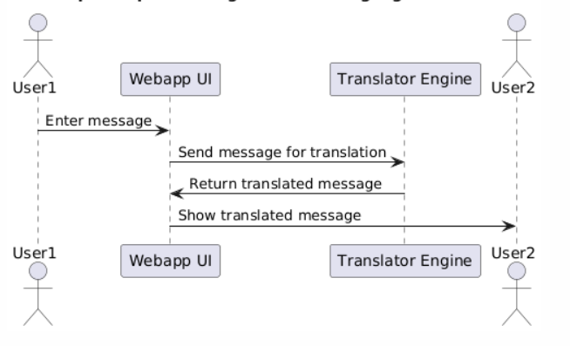
MALLA REDDY COLLEGE OF ENGINEERING AND TECHNOLOGY
Sequence Diagram
15
B.Tech III Year – II Sem | Dept of Computational Intelligence| Application Development – II | Project Review

Slide 16
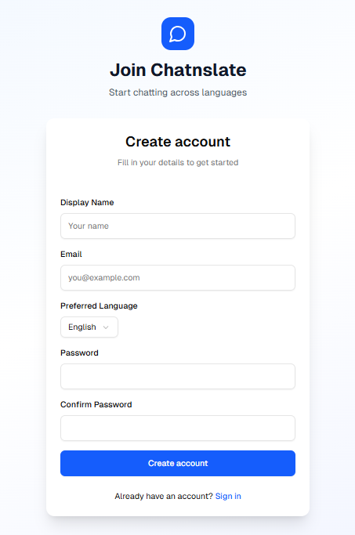
MALLA REDDY COLLEGE OF ENGINEERING AND TECHNOLOGY
Output Screens
16
B.Tech III Year – II Sem | Dept of Computational Intelligence| Application Development – II | Project Review

Slide 17
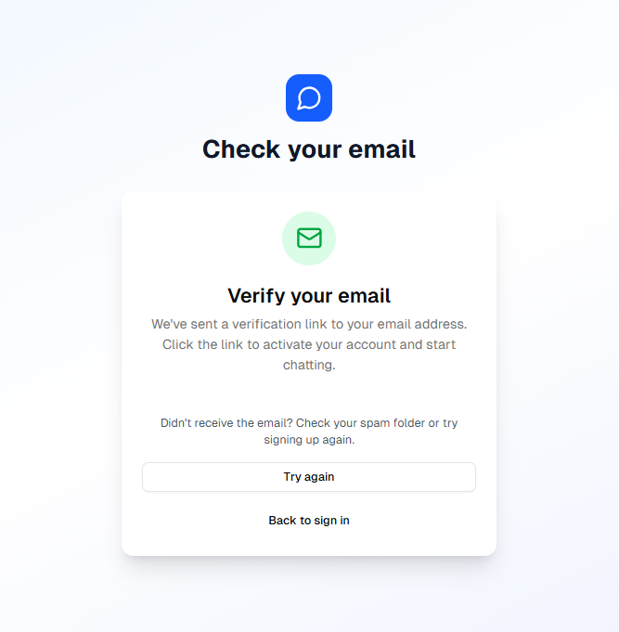
MALLA REDDY COLLEGE OF ENGINEERING AND TECHNOLOGY
Output Screens
17
B.Tech III Year – II Sem | Dept of Computational Intelligence| Application Development – II | Project Review

Slide 18
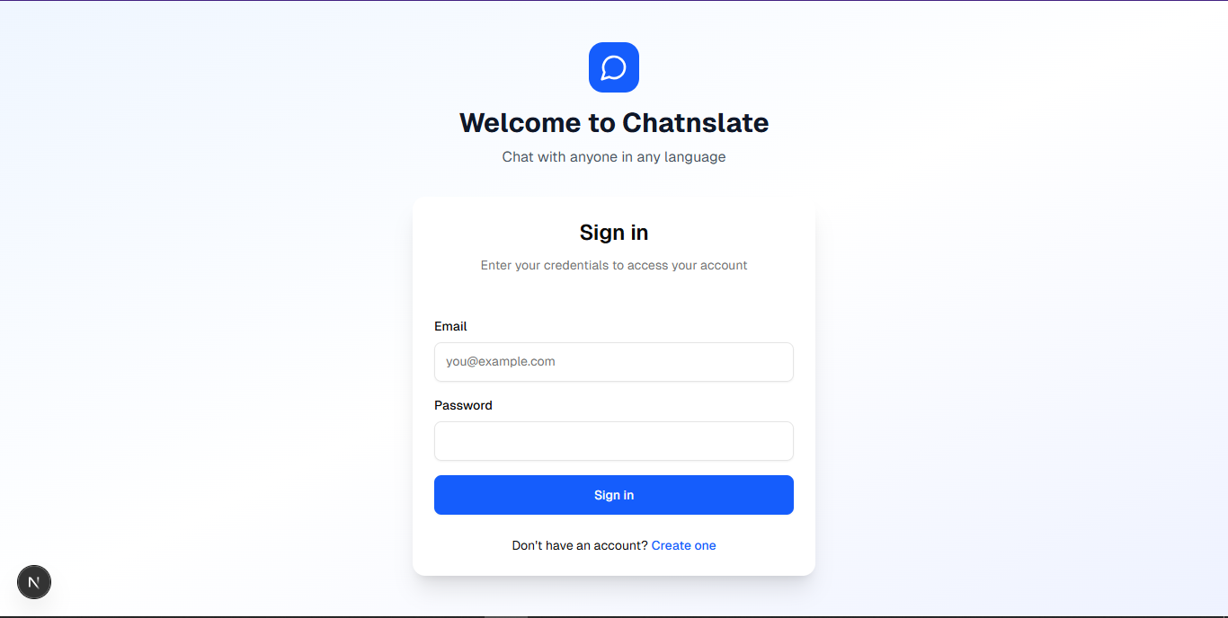
MALLA REDDY COLLEGE OF ENGINEERING AND TECHNOLOGY
Output Screens
18
B.Tech III Year – II Sem | Dept of Computational Intelligence| Application Development – II | Project Review

Slide 19
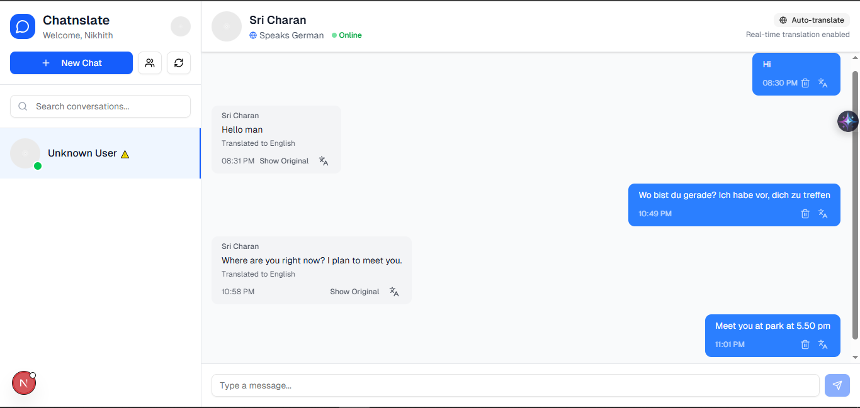
MALLA REDDY COLLEGE OF ENGINEERING AND TECHNOLOGY
Output Screens
19
B.Tech III Year – II Sem | Dept of Computational Intelligence| Application Development – II | Project Review

Slide 20
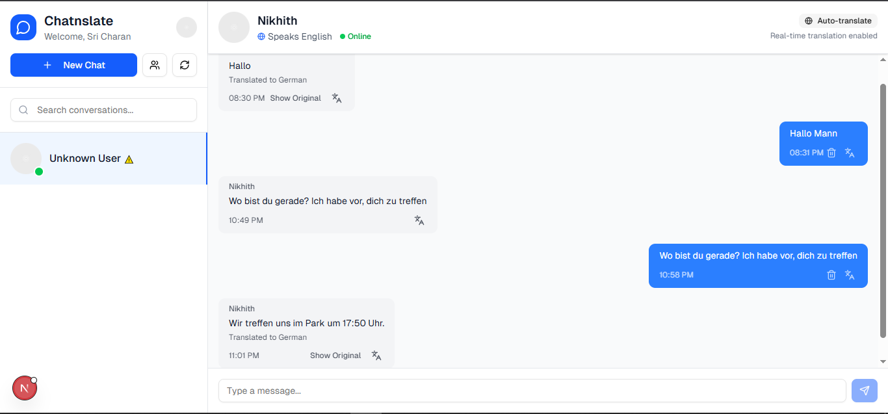
MALLA REDDY COLLEGE OF ENGINEERING AND TECHNOLOGY
Output Screens
20
B.Tech III Year – II Sem | Dept of Computational Intelligence| Application Development – II | Project Review

Slide 21
MALLA REDDY COLLEGE OF ENGINEERING AND TECHNOLOGY
Conclusion
The Live Language Translator webapp is a user-friendly chat platform that helps people from different countries talk to each other, even if they don’t speak the same language. It automatically translates messages in real time, so conversations feel smooth and natural, just like chatting on WhatsApp or Messenger. Built with Python and smart language technology (NLP), it makes global communication easy and instant — perfect for travel, teamwork, learning new languages, or making new friends around the world.
21
B.Tech III Year – II Sem | Dept of Computational Intelligence| Application Development – II | Project Review

